Slide 1
Web based Programming
4. The Basics of JavaScript

Slide 2
4.1 Overview of JavaScript (1)
Origins
  Client-side programming
  Originally developed by Netscape, as LiveScript
  Became a joint venture of Netscape and Sun in 1995, renamed JavaScript
  Example4-0.html

Slide 3
4.1 Overview of JavaScript (1)
Origins
  Client-side programming
  Originally developed by Netscape, as LiveScript
  Became a joint venture of Netscape and Sun in 1995, renamed JavaScript
JavaScript and Java are very different
  Main similarity: expression syntax, assignment statements and control statements
  JavaScript is dynamically typed, whereas Java is strongly typed (types are all known at compile time)
  JavaScript objects are dynamic, but Java objects are static

Slide 4
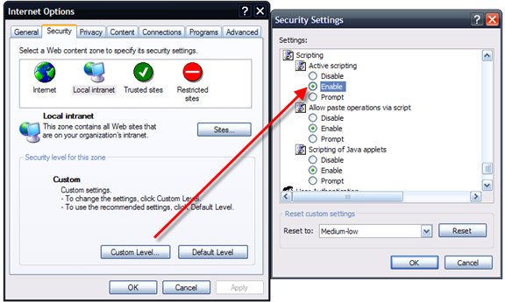
4.1 Overview of JavaScript (2)
We call the JavaScript code a script
  JavaScript scripts embedded in HTML document
  Browser uses its JavaScript interpreter to "execute" the scrip

Slide 5
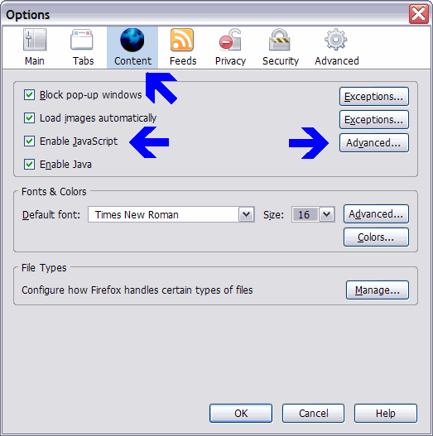
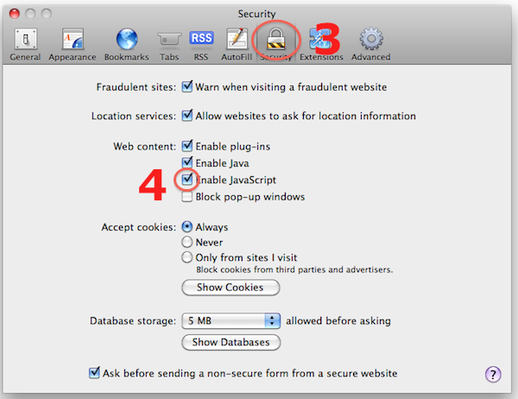
4.1 Overview of JavaScript (2)
We call collections of JavaScript code scripts
  JavaScript scripts embedded in HTML document
  Browser uses its JavaScript interpreter to "execute" the script

Slide 6

4.2 General Syntax (1)
JavaScript scripts are embedded in HTML documents
  Either directly, as in
  <script type = "text/javaScript">
  -- JavaScript script --
  </script>
  Or indirectly, as a file specified in the src attribute of <script>, as in
  <script type = "text/javaScript"
  src = "myScript.js">
  </script>
Scripts are usually hidden from browsers by putting them in special comments
  <!--
  -- JavaScript script --
  //-->
Notes:
Tips!
Scripts put in special comments, so those browsers which cannot interpret JavaScripts wouldn’t wrongly display the scripts.

Slide 7
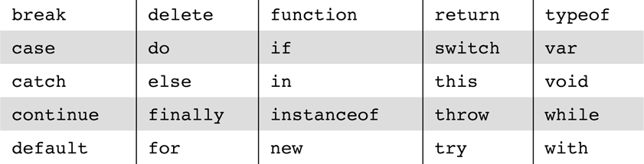
4.2 General Syntax (2)
Identifier begins with a letter or underscore, followed by any number of letters, underscores, and digits
Letters in variable names are case sensitive
Comments: both // and /* … */
25 reserved words, plus future reserved words

Slide 8
4.3 Primitives, Operations, & Expressions (1)
Values in JavaScript are either primitives or objects
JavaScript has five primitive types: Number, String, Boolean, Undefined, or Null
  Number
    All numeric literals are values of type Number, e.g. 72, 7.2, .72, 72., 7E2, 7e2, .7e2, 7.e2, 7.2E-2, 0x72, …
    All numeric values are stored in double-precision floating point
  String
    Can be delimited by either single quotes (') or double quotes (")
    Can include escape sequences (e.g. \n and \t)
    Use \', \" and \\ to represent actual single quotes, double quotes and backslash characters in strings
  Boolean: true or false
  Undefined: declared without assigning a value
  Null: undeclared

Slide 9
4.3 Primitives, Operations, & Expressions (2)
JavaScript is dynamically typed – any variable can be used for anything (primitive value or reference to any object)
Var for variable declaration
  var today = 0;
  today = "Monday";
  today = false;
  Variables are not typed, values are typed
Notes:
Tips!
A variable can be either implicitly declared by assigning it a value, or explicitly declared by listing it in a declaration statement that begins with the reserved word var

Slide 10
4.3 Primitives, Operations, & Expressions (3)
Operators
  Numeric operators: ++, --, +, -, *, /, %, same as Java
  String concatenation operator: +
    e.g. if first is "abc", first + "def" is "abcdef"
  Coercion
    7 * “3” (string to number)
    “August” + 1977 (number to string)
Notes:
Tips!
All numeric operations are done in double-precision floating point
Just like C++ and Java, there is a simple assignment operator =, and a host of compound assignment operators such as +=, /=, e.g. a += 7 means a = a + 7
Numeric operators other than + convert strings to numbers, e.g. 7 * "3" is 21
Conversions from strings to numbers that do not work return NaN
If either operand of a + operator is a string, the operator is interpreted as a string concatenation operator; if the other operand is not a string, it is coerced to a string, e.g. "August " + 1977 is "August 1977“

Slide 11
4.4 Object and JavaScript (1)
JavaScript is NOT an object-oriented programming language
  It is an object-based language
  JavaScript does not have classes
  Without classes, JavaScript does not support class-based inheritance etc.
JavaScript Objects
  JavaScript objects are collections of properties, which are like the members of classes in Java and C++ (but dynamically typed and maintained)
    Each property is either a data property (we simply call it property) or a method property (we call it method)
  All JavaScript objects are accessed through references

Slide 12
4.4 Object and JavaScript (2)
Number, String, and Boolean have wrapper objects (Number, String, and Boolean)
The Number Object
  Number object has the toString method that converts the number to a string
    var price = 427, str_price;
    str_price = price.toString();

Slide 13
4.4 Object and JavaScript (3)
The String Object
  length property: if str is "George", str.length is 6
  charAt(position) method: str.charAt(2) is "o" (character positions start at zero)
  indexOf(one-character string) method: str.indexOf('r') is 3
  substring(from, to) method: str.substring(2, 4) is "org"
  toLowerCase() method: str.toLowerCase() is "george"
  toUpperCase() method: str.toUpperCase() is "GEORGE"

Slide 14
4.4 Object and JavaScript (4)
The Math Object provides methods for commonly used mathematical operations
  floor – to truncate a number
  round – to round a number
  max, min – to return the smallest and largest of two given numbers
  trigonometric functions such as sin and cos, e.g. Math.cos(x);

Slide 15
4.5 Screen Output (1)
The model for the browser display window is the Window object
  The Window object provides the largest enclosing referencing environment for JavaScript scripts
  The Window object has two properties, document and window, which refer to the Document and Window objects, respectively
  The Document object represents the displayed XHTML document

Slide 16
4.5 Screen Output (2)
The Window object has three methods for creating dialog boxes, alert, confirm, and prompt
  alert("Hey! \n");
  confirm("Do you want to continue?");
  prompt("What is your name?", "");
  Example4-1.html

Slide 17
4.5 Screen Output (3)
The Document object has a method, write, which dynamically creates content
  The parameter is a string, often concatenated from parts, some of which are variables
  e.g. document.write("Answer: " + result + "<br />");
  The parameter is sent to the browser, so it can be anything that can appear in an HTML document

Slide 18
4.6 Control Statements (1)
Similar to C, Java, and C++
Selection Statements
  if-then-else statement
  switch statement
  switch (expression) {
  case value_1:
  // statement(s)
  case value_2:
  // statement(s)
  …
  [default:
  // statement(s)]
  }

Slide 19
4.6 Control Statements (2)
Loop statements
  while statement
  while (control expression)
  statement or compound statement
  for statement
  for (initial expression; control expression; increment expression)
  statement or compound statement
  do-while statement
  do
  statement or compound statement
  while (control expression)
  Example4-3.html

Slide 20
4.6 Control Statements (3)
Control expressions
  Relational expressions
    The usual six: ==, !=, <, >, <=, >=
    coercions: string, Boolean -> number;
    The unusual two === and !==: same as == and !=, except that no coercions are done (operands must be identical)
      "3" === 3 evaluates to false, while "3" == 3 evaluates to true
    Comparisons of references to objects are not useful (addresses are compared, not values)
      a == b is true only if a and b reference the same object
  Compound expressions
    The usual operators: &&, ||, and !

Slide 21
4.7 Object Creation and Modification (1)
Objects can be created with new expression
  The most basic object: Object constructor
  var myObject = new Object();
  The new object has no properties – a blank object
Properties can be added to an object at any time
    var myAirplane = new Object();
    myAirplane.make = "Cessna";
    myAirplane.model = "Centurian";
Objects can be nested, so a property could be itself another object created with new
  myAirplane.engine = new Object();
  myAirplane.engine.config = "…";
Notes:
Tips!
Object construction: Calls to constructors must include parentheses, even if there are no parameters

Slide 22
4.7 Object Creation and Modification (2)
Properties can be accessed by dot notation or in array notation, as in
  var property1 = myAirplane.model;
  var property2 = myAirplane["model"];
Another loop statement for listing the properties of an object
  for (identifier in object)
  statement or compound statement
  e.g.,
  for (var prop in myAirplane)
  document.write(myAirplane[prop] + "<br />");
A property can be deleted with delete, as in
  delete myAirplane.model;

Slide 23
4.8 Arrays (1)
Arrays are objects with some special functionality
Array elements can be primitive values or references to other objects
Array objects can be created in two ways, with new, or by assigning an array literal
  The elements of an array need not to have the same type
  var myList = new Array(24, "bread", true);
  var myList2 = [24, "bread", true];
  var myList3 = new Array(100); // this creates a new array object of length 100 without actually creating any elements
  Whenever a call to the Array constructor has a single parameter, that parameter is taken to be the number of elements, not the initial value of a one-element array
Notes:
Tips!
The Array constructor is able to know the number of parameters from the length of “argument” array

Slide 24
4.8 Arrays (2)
Length is dynamic – the length property stores the length
  myList[122] = "bitsy"; // length is 123
  Because the length property is writeable, you can set it to make the array any length you like, as in myList.length = 150;
  Shrink an array by setting its length property to a smaller value
Example4-4.html

Slide 25
4.8 Arrays (3)
Array methods
  join – convert all elements of an array to strings and concatenate them into a single string
    e.g. var myList = new Array("One", "Two", "Three", "Four");
    var listStr = myList.join(", ");
    // listStr is "One, Two, Three, Four"
  reverse – reverse the order of the elements in an array
  sort – coerce array elements to strings (if they are not already strings) and put them in alphabetical order
    e.g. myList.sort();
    // myList is now ["Four", "One", "Three", "Two"]
  concat – append the parameters to the end of an array
    e.g. newList = myList.concat("Five", "Six");
    // newList is ["One", "Two", "Three", "Four", "Five", "Six"]

Slide 26
4.8 Arrays (4)
  slice – return part of an array with subscripts from the first parameter up to, but not including the second parameter
    e.g. listPart = myList.slice(1, 3);
    // listPart is ["Two", "Three"]
    listPart2 = myList.slice(1);
    // listPart2 is ["Two", "Three", "Four"]
    If only one parameter is given, all elements with subscripts from the parameter up to the end of an array are returned
  toString – coerce array elements to strings and concatenate them together, separated by commas (exactly like join(","))
A two dimensional array is implemented as an array of arrays
Example4-5.html
Notes:
Tips!
We can treat an array as a stack or queue:
push, pop – remove and add an element to the end of an array
unshift, shift – remove and add an element to the beginning of an array

Slide 27
4.9 Functions (1)
A function definition consists of the function’s header and a compound statement that describes its actions
  Form: function function_name([parameters]) {
  – body –
  }
  Function definitions are placed in the head of an XHTML document
Functions are objects, so variables that reference them can be treated as other object references, e.g.
  ref_fun = fun; // suppose that fun is the name of a function
  fun(); // a call to fun
  ref_fun(); // also a call to fun

Slide 28
4.9 Functions (2)
The scope of a variable is the range of statements over which it is visible
  Variables that are either explicitly declared outside functions or implicitly declared have global scope
  Variables explicitly declared in a function have local scope
Parameters are passed by value, resulting in pass-by-value semantics for primitives and pass-by-reference semantics for objects (since references to objects are passed)
Example4-6.html
Notes:
Tips!
There is no type checking of parameters, nor is the number of parameters checked
Function definitions do not include type names of parameters
If there are more parameters in a function call than in the function definition, excess parameters are ignored
If there are more parameters in the function definition than in a function call, excess parameters are set to undefined
All parameters are passed through a property array – arguments, which has the length property

Slide 29
4.9 Functions (2)
The scope of a variable is the range of statements over which it is visible
  Variables that are either explicitly declared outside functions or implicitly declared have global scope
  Variables explicitly declared in a function have local scope
Parameters are passed by value, resulting in pass-by-value semantics for primitives and pass-by-reference semantics for objects (since references to objects are passed)
Example4-6.html
var myList = new Array(24, "bread", true); // an array of element 24, “bread” and true
var myList = new Array(100); // an array of 100 elements
Notes:
Tips!
There is no type checking of parameters, nor is the number of parameters checked
Function definitions do not include type names of parameters
If there are more parameters in a function call than in the function definition, excess parameters are ignored
If there are more parameters in the function definition than in a function call, excess parameters are set to undefined
All parameters are passed through a property array – arguments, which has the length property

Slide 30
4.10 Constructor
Constructors are special methods that create and initialize the properties for newly created objects
  The function name is the same as the object being created
  this is a predefined reference variable to the object created
    function plane(newMake, newModel, newYear){
    this.make = newMake;
    this.model = newModel;
    this.year = newYear;
    }
    myPlane = new plane("Cessna", "Centurnian", "1970");
  Can also have method properties, e.g.
    function displayPlane() {
    document.write("Make: ", this.make, "<br />");
    document.write("Model: ", this.model, "<br />");
    document.write("Year: ", this.year, "<br />");
    }
    Add this.display = displayPlane; to the constructor
    To call the function, myPlane.display();

Slide 31
4.11 Pattern Matching (1)
search(pattern) returns the position in the String object where the pattern matched; it returns -1 if there is no match
  var str = "Mr. Blue has a blue house";
  var position = str.search(/blue/); // position is now 15
Patterns are delimited with slashes
Two categories of characters in patterns:
  Normal characters (match themselves)
  Metacharacters: \ | ( ) [ ] { } ^ $ * + ? . (can have special meanings in patterns – do not match themselves)
    A metacharacter is treated as a normal character if it is preceded by a backslash, e.g. /3\.4/ matches 3.4
    Period is a special metacharacter – it matches any character except newline, e.g. /snow./ matches snowy, snowe, and snowd etc.; /3.4/ would match 3.4 and 374

Slide 32
4.11 Pattern Matching (2)
Character classes
  Put a sequence of characters in brackets, and it defines a set of characters, any one of which matches
  [abcd]
  Dashes can be used to specify spans of characters in a class
  [a-z]
  A circumflex character at the left end of a class definition means the opposite
  [^0-9]
  Predefined character class abbreviations
    Name Equivalent Pattern Matches
    \d [0-9] a digit
    \D [^0-9] not a digit
    \w [A-Za-z_0-9] a word character
    \W [^A-Za-z_0-9] not a word character
    \s [ \r\t\n\f] a whitespace character
    \S [^ \r\t\n\f] not a whitespace character

Slide 33
4.11 Pattern Matching (3)
Quantifiers
  Quantifiers in braces
  Quantifier Meaning
  {n} exactly n repetitions, e.g. /xy{4}z/ matches xyyyyz
  {m,} at least m repetitions
  {m, n} at least m but not more than n repetitions
  Other quantifiers (just abbreviations for the most commonly used quantifiers)
    * means zero or more repetitions
    e.g. \d* means zero or more digits
    + means one or more repetitions
    e.g. \d+ means one or more digits
    ? Means zero or one repetition
    e.g. \d? means zero or one digit
    e.g. /x*y+z?/ matches strings that begin with any number of x, followed by one or more y, possibly followed by z

Slide 34
4.11 Pattern Matching (4)
Anchors
  The pattern can be forced to match only at the beginning with ^; at the end with $
  e.g. /^Lee/ matches "Lee Ann", but not "Mary Lee Ann"
  /Lee Ann$/ matches "Mary Lee Ann", but not "Mary Lee Ann is nice"
  The anchor operators (^ and $) do not match characters in the string – they match positions, at the beginning or end
Other pattern matching methods of string
  replace(pattern, string) – find a substring that matches the pattern and replace it with the string
    g modifier is used if the replacement is to be global in the string
    var str = "Some rabbits are rabid";
    str.replace(/rab/g, "tim");
    // str is now "Some timbits are timid"

Slide 35
4.11 Pattern Matching (5)
  match(pattern) – the most general pattern-matching method that returns an array of results of the pattern-matching operation
    Return the first matched substring
    var str = "My 3 kings beat your 2 aces";
    var match = str.match(/[ab]/);
    // match is set to "b"
    With g modifier, it returns an array of all substrings that match
    var matches = str.match(/[ab]/g);
    // matches is set to ["b", "a", "a"]
  split(parameter) – split the string into substrings and return them in an array, based on the given string or pattern
    var str = "grapes:apples:oranges";
    var fruit = str.split(":");
    // fruit is set to ["grapes", "apples", "oranges"]
Example4-7.html

